Slide 1
Thursday 21st November

Slide 2
Session times
P1- 9.30-10.15
P2- 11-11.45
P3- 2-2.45

Slide 4
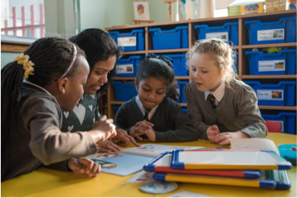
Read, Write, Count is…
a campaign to improve the literacy and numeracy skills of Scotland’s children.
It aims to help parents support their child’s learning by incorporating simple, fun activities in to everyday life.
Notes:
Read, Write, Count is a campaign by the Scottish Government, supported by Scottish Book Trust and Education Scotland. It focuses on the importance of families, parents and carers in children’s education and aims to give advice and materials to help families get involved in their children’s learning.
As part of the campaign, every child in Primary 2-3 receives a free bag with books and activities to support their learning. In addition, the campaign provides advice and support for learning professionals and families through Scottish Book Trust and Parent Club, in the form of training events, online resources and useful advice. It is a key part of the Scottish Government’s commitment to raise attainment for all.
A key part of the campaign is parental and family engagement with children’s learning. Research tells us that if parents are involved in their child’s learning, their child does better in school. The campaign therefore aims to ensure that parents and carers are empowered to get involved in their child’s learning and recognise the importance of this.

Slide 5
Read, Write, Count aims to. . .
Help parents and carers to be confident enough to be involved in their child’s learning; to understand why they are important in their child’s learning and how to get involved
Increase families’ use of their local library
Help to close the attainment gap between the most and least advantaged children in Scotland

Slide 6
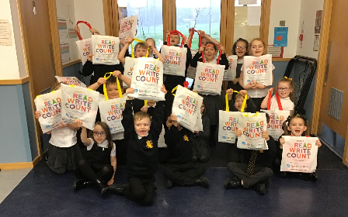
Read, Write, Count: Gift Bags
Free gift bags to all Primary 1, 2 and 3 children in Scotland
Containing books and materials for writing and counting
Information for parents and carers on how to use the bags with their children
Notes:
One of the biggest parts of the Read, Write, Count campaign is the free bags which are gifted to every Primary 2 and Primary 3 child in Scotland. There is also an element of Read, Write, Count in the P1 bags, which are an extension of the Bookbug programme and include three picture books as part of the Bookbug Picture Book Prize.
The bags contain a selection of books and materials for writing and counting. These materials have all been carefully selected so that they are fun to use at home and can be incorporated into activities in both classrooms and libraries.

Slide 7
video
https://www.scottishbooktrust.com/reading-and-stories/about-read-write-count

Slide 8
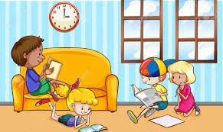
Reading at home
Your child will be given a reading book home to practise reading.
Read through it with them
Discuss the story
Also explore a range of texts
Discuss different genres of books- information texts, magazines, story books, recipe books
Discuss different authors- discuss their writing style

Slide 10
Reading strategies
Think about the strategies your child is using
when reading.
Are they able to blend sounds
together to read a word?
Do they use clues to help them work out a
word they are unsure of?- picture clues,
context clues

Slide 11
Comprehension
Think about the questions you are asking
when reading with your child.
What have they understood?
Can they predict what will happen next?
Can they discuss the story?
Have they shown good understanding?

Slide 12
Questions to ask
During reading -
Can you find 3 interesting words? What do they mean?
Look at the pictures and the front cover. What might the book be about?
Do you have any questions about the text?
After reading-
Can you summarise the story?
Did the book end the way you expected?
Were you happy with the ending?
Is there anything you would change?
What was your favourite part?

Slide 13
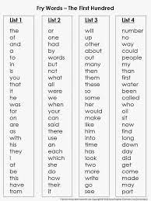
Common/ tricky words
High frequency words
Common words or tricky words are our sight words.
These are words we just have to learn.
They are commonly used words in
reading and writing.
These are words children need to
learn to recognise

Slide 14
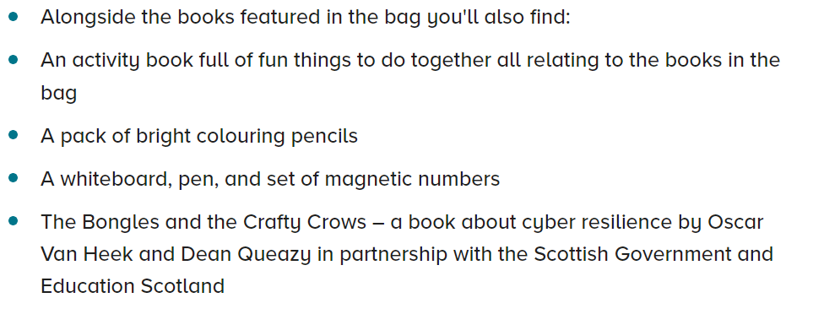
P1 bag

Slide 15
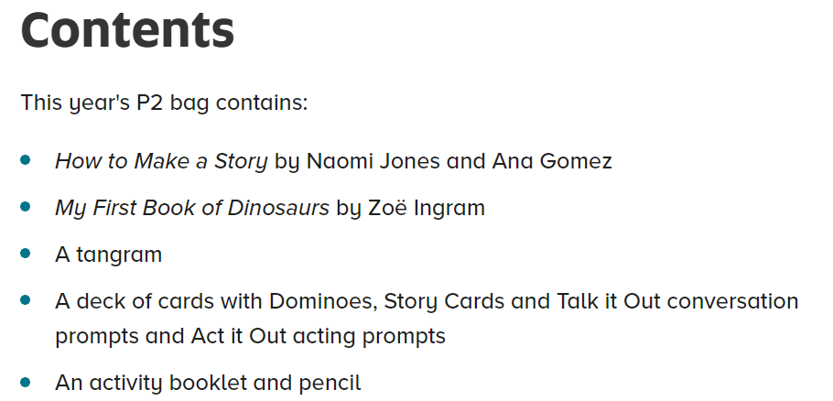
P2 bag

Slide 16
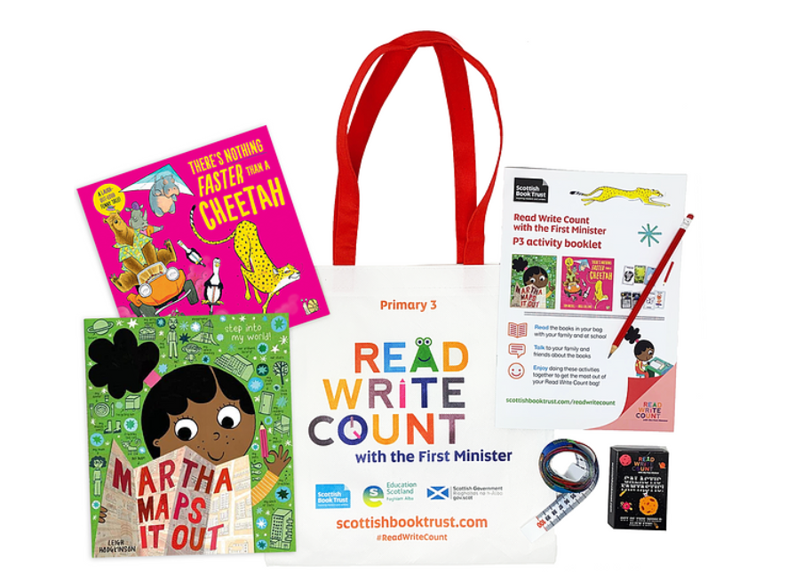
P3 bag

Slide 17
Activities
There are some amazing ideas that can go along with your Read Write Count bag that we will pop up on Seesaw and on the school website.

Slide 18
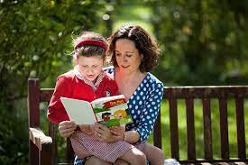
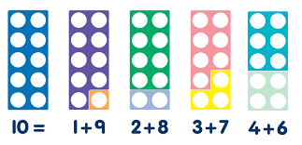
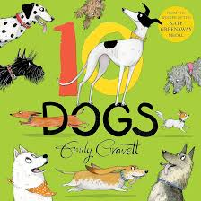
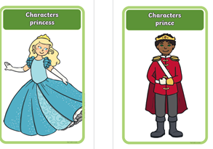
Activities today- P1
read | write | count
Reading area for you to read with your child and discuss the story Use the story cards to make up your own story. Choose a character, setting and item. | Draw a picture of a dog. Think of some words to describe the dog or write a sentence about it. | Use the Numicon to find ways to make 10

Slide 19
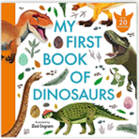
Activities today- P2
read | write | count
Reading area for you to read with your child and discuss the story Use the story cards to make up your own story. Choose a character, setting and item. | Draw some dinosaurs. Label or write some information about them. | Laptops and Ipads- Try the interactive Tangram puzzles

Slide 20
Activities today-P3
read | write | count
Reading area for you to read with your child and discuss the story Use the story cards to make up your own story. Choose a character, setting and item. | Write a list of all of the animals you think a cheetah would beat in a race. | Measure- use the measuring tapes to measure the resources on the table

Slide 21
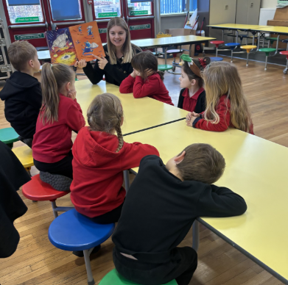
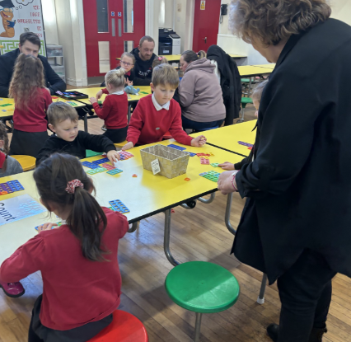
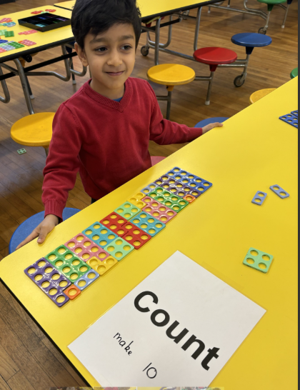
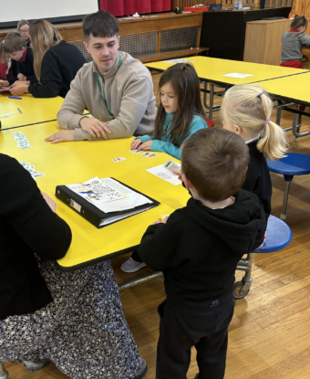
Pictures from the event- P1

Slide 22
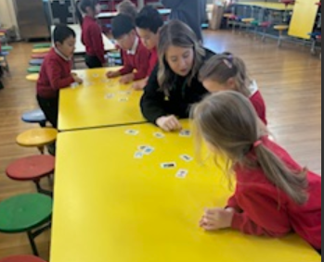
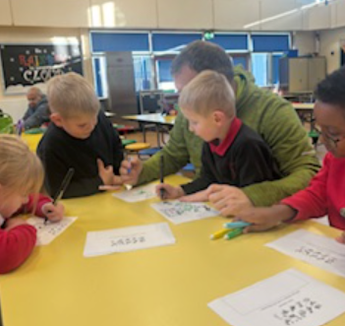
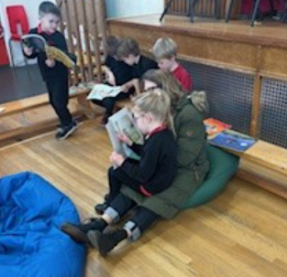
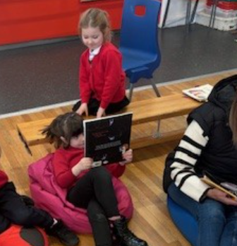
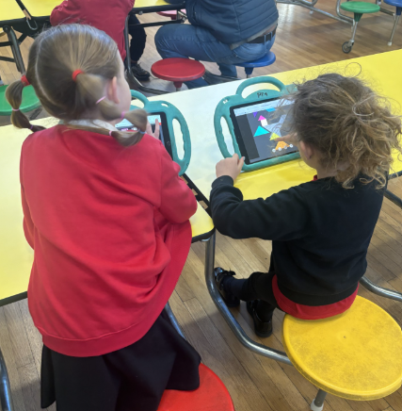
Pictures from the event- P2

