Slide 1
World book day Our Events

Slide 2
World Book Day
Thursday 6th March 2025
P4-7 event 9am-10am

Slide 3
A huge concern for every parent right now is screen time
Can we look at replacing screen time with reading time
Especially before bed
Contributes to mental health

Slide 5
Strategies to support reading at home
Engage in conversation: Ask questions about the story, discuss characters and plot points, and encourage your child to share their thoughts.
Choose diverse books: Explore different genres and authors to broaden reading horizons.
Vocabulary building: Point out new words, explain their meanings, and use them in conversation.
Let them choose: Give your child some autonomy in selecting books they want to read.
Create a reading nook: Designate a quiet, comfortable space for reading.
Visit the library: Regularly take trips to the library to discover new titles.
Connect reading to real life: Discuss how stories relate to their own experiences or current events.
Model reading behavior: Show your child that you enjoy reading by reading yourself.
Practice reading strategies: Depending on your child's needs, teach them strategies like sounding out words or using context clue
Read aloud often: Make reading together a daily routine, choosing books appropriate for your child's age and interests.

Slide 6
Supporting age 8 to 9 readers
https://youtu.be/0ZBDNrZsoCQ
Supporting age 10-11 readers at home
https://youtu.be/f3WCejdwBkY

Slide 7
Before, After and During reading activities

Slide 8
Reading strategies

Slide 9
2nd level reading
Enjoyment and choice

Slide 10
Finding and using information

Slide 11
Understanding, Analysing and Evaluating

Slide 12
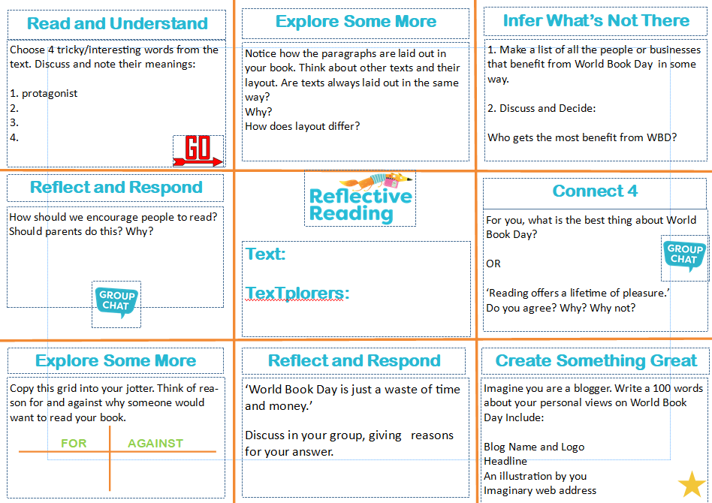
Todays tasks
Silly word finders – find the silly words in the text and replace them with better words
Reflective Reading task mat- complete a few activities from the task mat
Reading
Reading tasks- reciprocal reading tasks

Slide 13
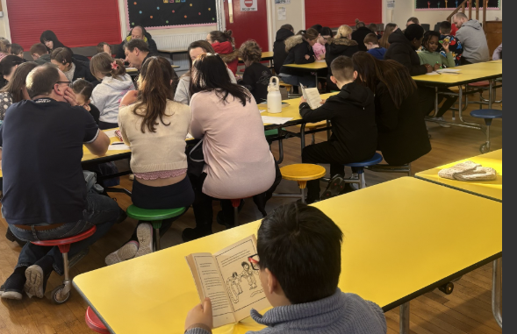
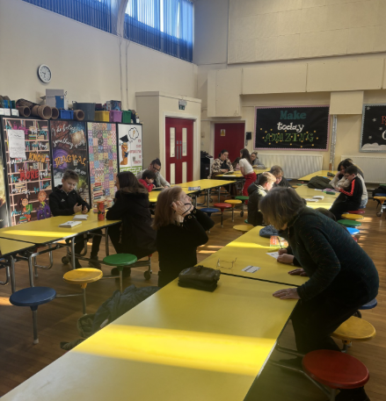
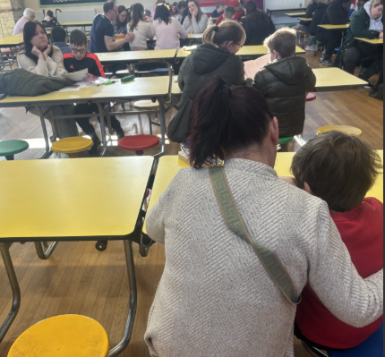
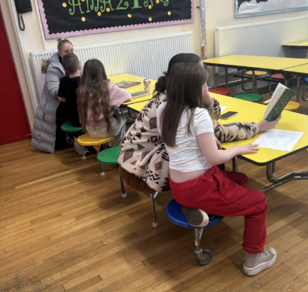
P4-7 event

Slide 14
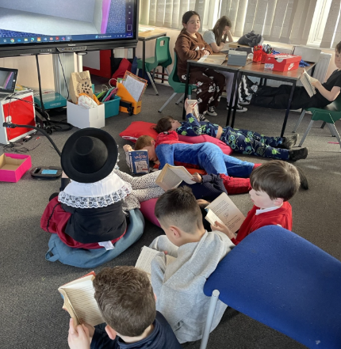
Drop everything and read

Slide 15
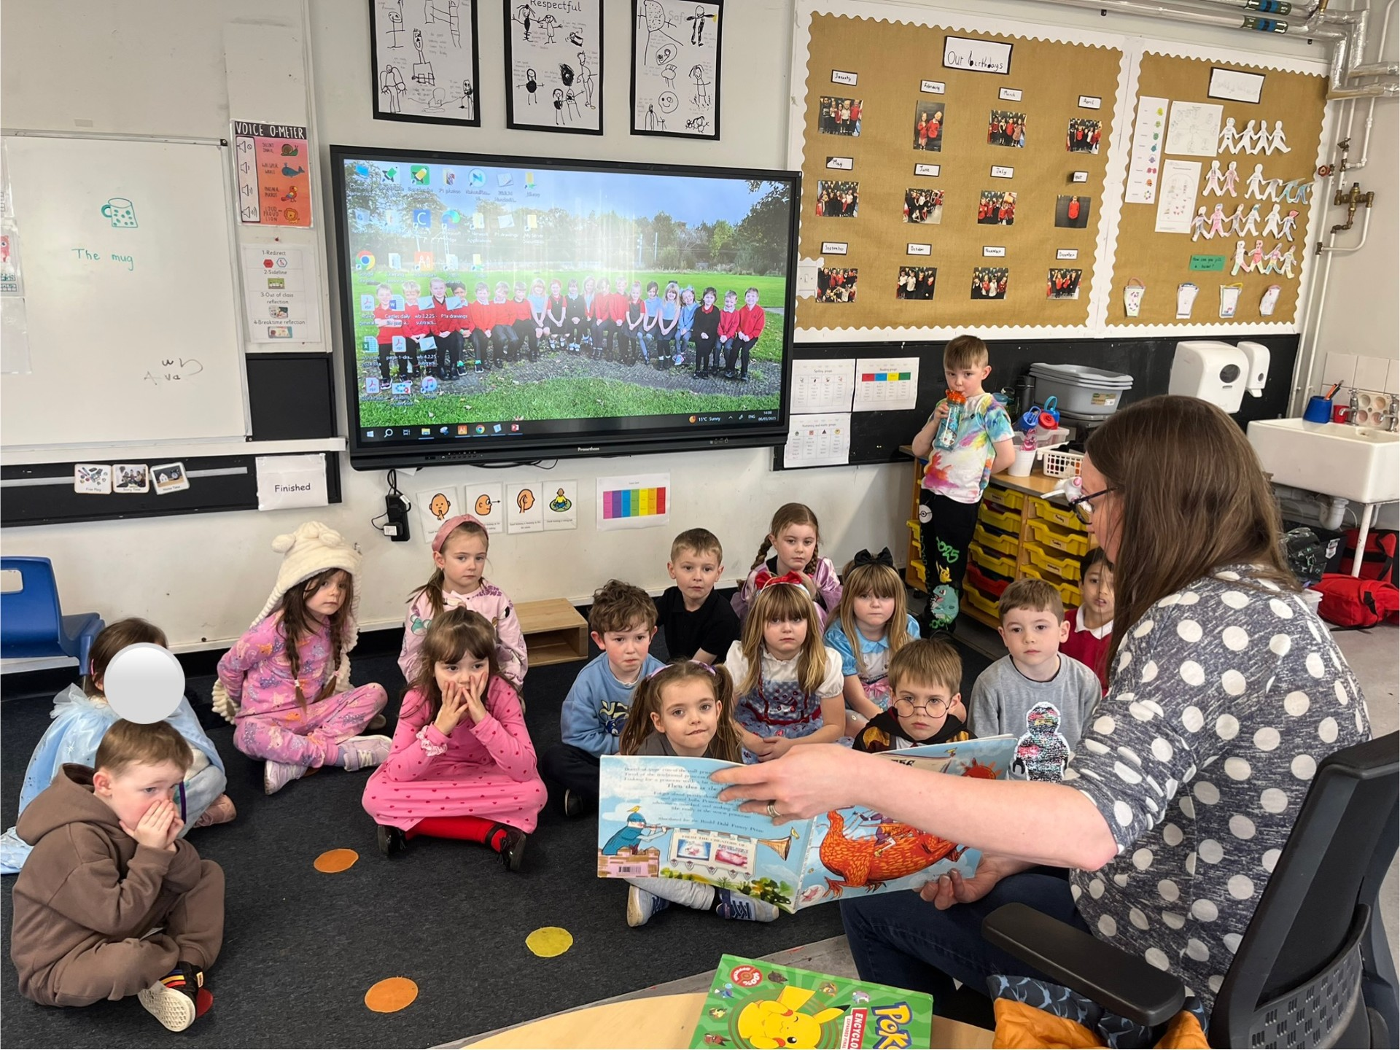
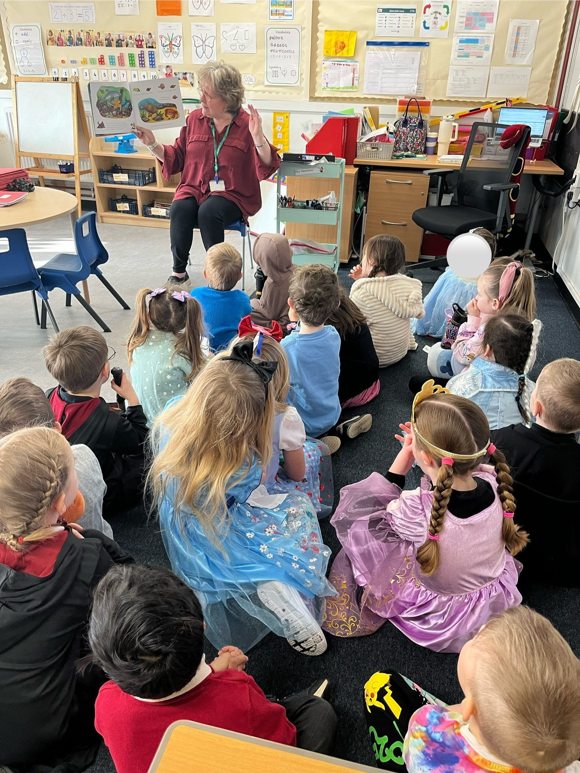
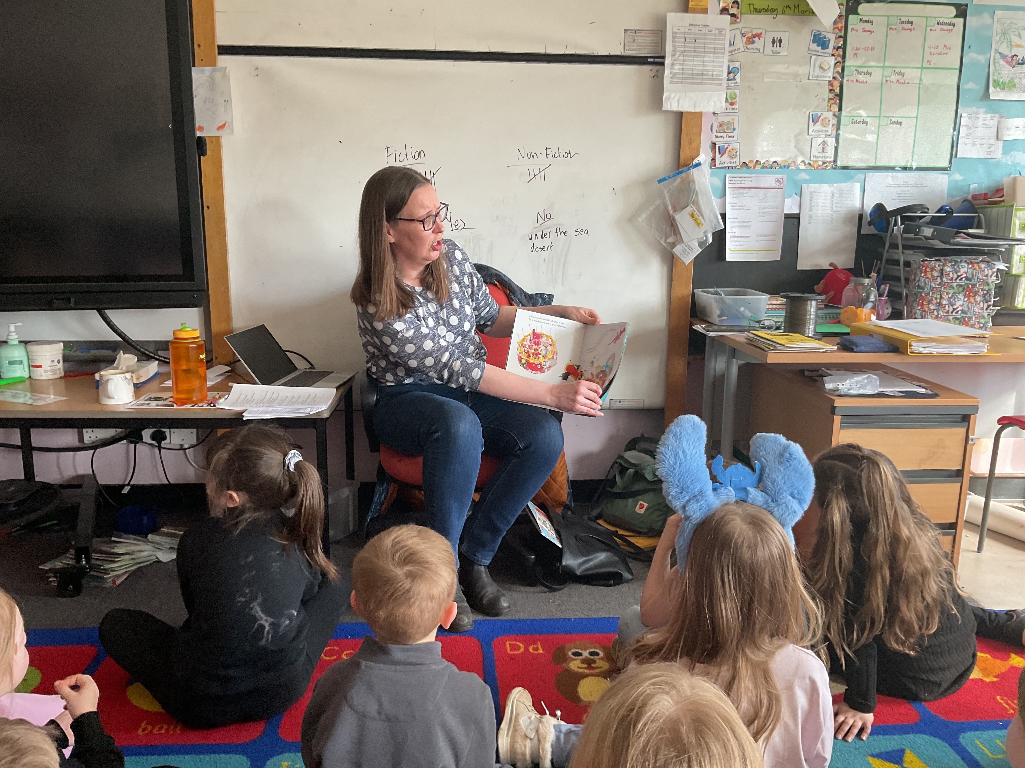
Parent Storytellers

