Slide 1
Time to Talk day
Thursday 6th February

Slide 2
Todays session
2-2.30pm- Parent Talk time
Mrs Savage- information about school wide HWB resources
Parents- sharing worries or concerns as well as strategies or tips
Educational Psychology department- sharing information about the service
2.30-3pm – Parent and Child Talk time
Time to talk to your own child about their worries or concerns

Slide 3
Think alone or be brave and share!!
How are you today?
How has your day been?
What has gone well for you today?
What was your main struggle of the week?

Slide 4
Parents managing emotions

Slide 5
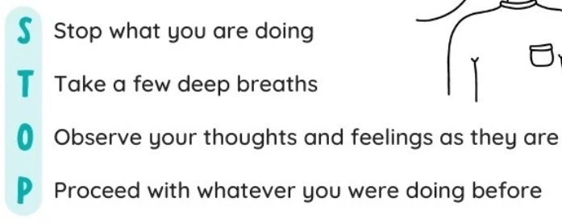
Dealing with frustrations and big emotions as a parent
Accept your child for who they are- no 2 children are the same- work out what works for them and you together
Allow and accept your emotions- children should see that you have emotions
When a strong feeling or frustration arises practise STOP

Slide 6
When we ignore a feeling we become ‘stuck’ feeling that way. If we accept and deal with it, it’s gone in 2 minutes
Communicate your feelings clearly and effectively- ‘mummy is feeling really tired and grumpy right now’
But also communicate that these feelings don’t last us forever
Practise gratitude- developing a positive mindset- I have to take my child to dancing on Saturday vs I get to take my child to dancing on Saturday
Apply a growth mindset to parenting – parenting has a new lesson each day!!

Slide 7
Some Mental Health Myths
“ Nowadays, mental health is accepted and talked about positively.”
True or False?

Slide 8
False
Mental health stigma and discrimination is still a big problem – from portrayals in the media to getting support. By taking part in Time to Talk Day,

Slide 9
“ Events in the news can have an impact on our mental health.”

Slide 10
True
Some news can highlight a difficult reality and coverage can seem constant through 24-hour TV, news websites and social media. For many of us, these issues aren’t only in the headlines – they impact our daily lives. Events may affect each of us differently depending on our own views and experiences.

Slide 11
Young people are more willing to talk about mental health.”

Slide 12
False
Young people are even more likely to bottle up their feelings. Our Time to Talk Day 2024 survey showed that 69% of 16-24 year-olds report putting on a brave face, compared to 28% of over-75s.

Slide 13
“ The general public is happy to talk about mental health.”

Slide 14
False
Research from Time to Talk Day 2024 revealed that nearly two thirds of people surveyed in the UK put a brave face on to avoid talking about their mental health.

Slide 15
Lets think and share
What are the main worries our families in our Parkhead community face?
What are the main worries you think our children have?
Feel free to discuss these amongst yourselves
Please write down some examples and put them up on our board

Slide 16
So what can we do?
In an ideal world what would help our children?
What top tips can you share that work for you?
What strategies could you suggest to others?

Slide 17
What do we do at Parkhead
Each term we do a Health and wellbeing check in with pupils
P1-3 face check in
P4-7 online
This is also monitored and any changes are identified

Slide 18
P1-3 HWB termly check in

Slide 19
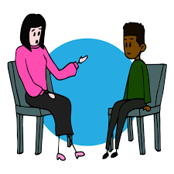
Trusted Adult
Children select a Trusted Adult

Slide 20
Trusted Adult Conversations

Slide 21
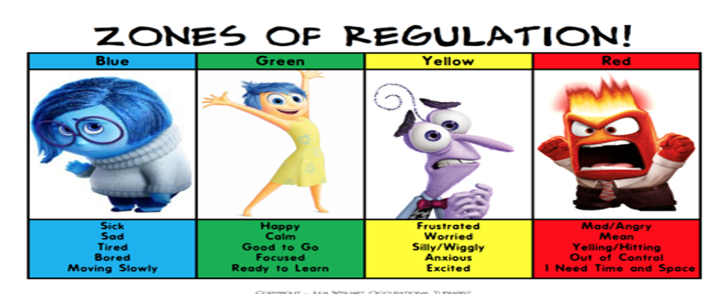
Daily check ins
Zones of regulation

Slide 22
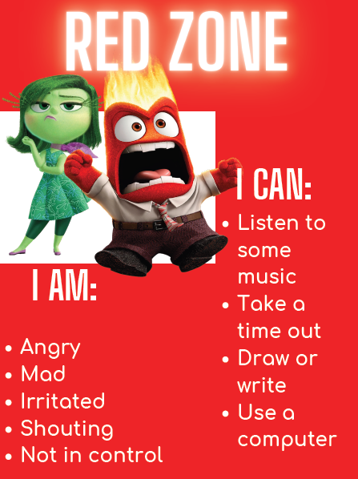

Slide 23
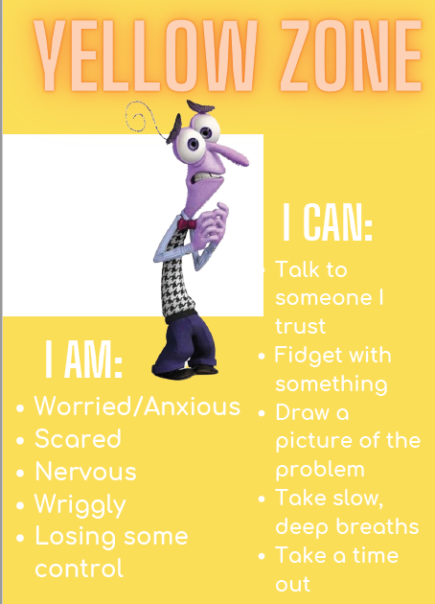
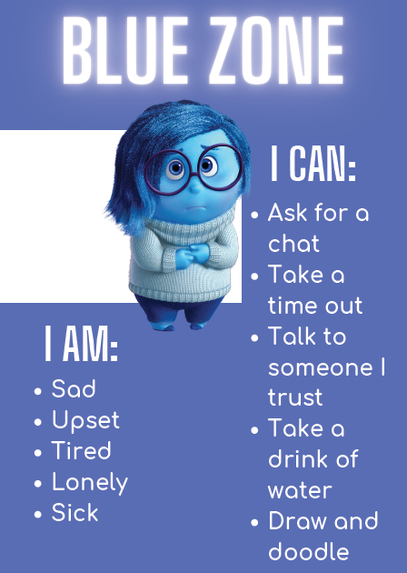

Slide 24
Calm kits

Slide 25
Mental Health Week event last year

Slide 26
West Lothian resource- West Space

Slide 27
Resources to share
Information and resources will be posted on our school website

Slide 28
2.30-3pm- Child and Parent Time to talk session
Have a focused discussion around emotions and feelings with your child.
Think of things they enjoy doing and decide on some things that would help them when they feel worried or overwhelmed

