Slide 1
PGL Dalguise Information Evening

Slide 2
Welcome, Campers!
Miss Hart
Mr Jeffrey
Mrs Davidson
Mrs Russell

Slide 3
Itinerary Day 1
10:00 Depart for bus at WCHS
11:30/12:00 Arrival at Dalguise (Groupcall)
13:00 – 14:00 Dorms/orientation/lunch (packed)
14:00 – Activity 1

Slide 4
Itinerary

Slide 5
Itinerary Day 3
Breakfast
9.00 – Activity 1
10:40 – Activity 2
Lunch
13:00 – Departure – Groupcall – collect WCHS

Slide 6
Preparing for Travel…
Medication
Travel sickness
Asthma

Slide 7
Food, glorious food!
Please be sure to check out the menu online.
Camp staff are very flexible and aim to make sure tummies are full!
Feel free to bring snacks (within reason).

Slide 8
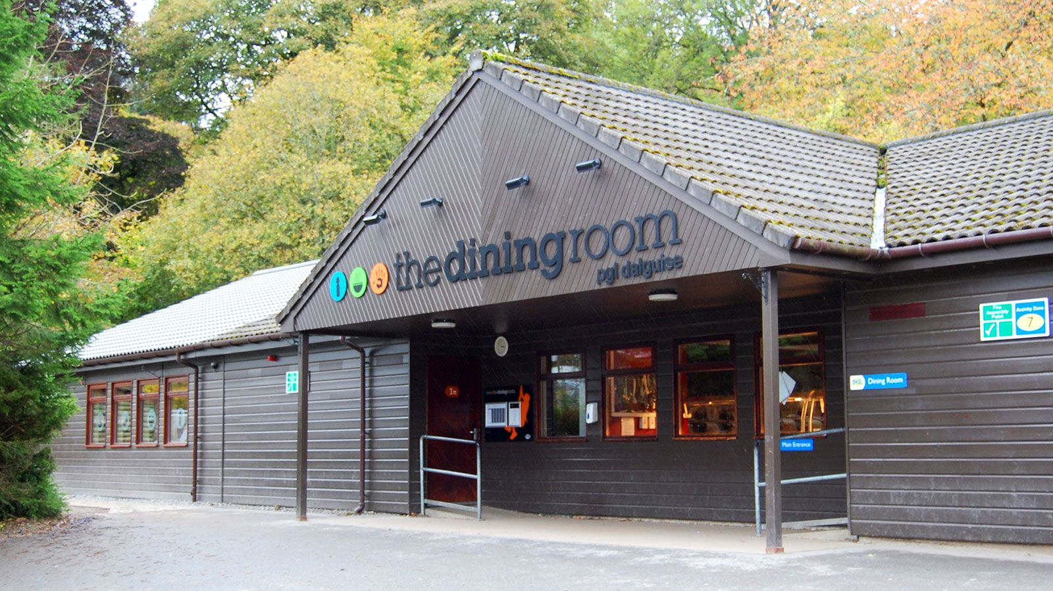

Slide 9
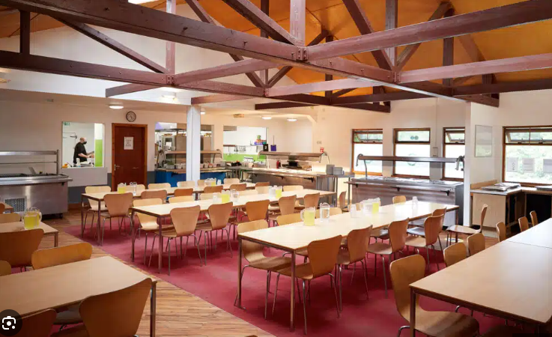

Slide 10
What to bring..
Bedding – Pillow/Sleeping bag
Torch
Books/Games/Magazines
Cuddly toy
See kit list
Please label your clothing
Your bag…let’s chat

Slide 11
What NOT to bring..
Mobile Phone
Any communication devices (Watches, ipad, carrier pigeon)

Slide 12
What to expect when we arrive
Welcome by camp staff
Safety and expectations
Dorms/luggage drop off
Walking up hill!!!
Getting to know your surroundings
Ground rules/expectations

Slide 13
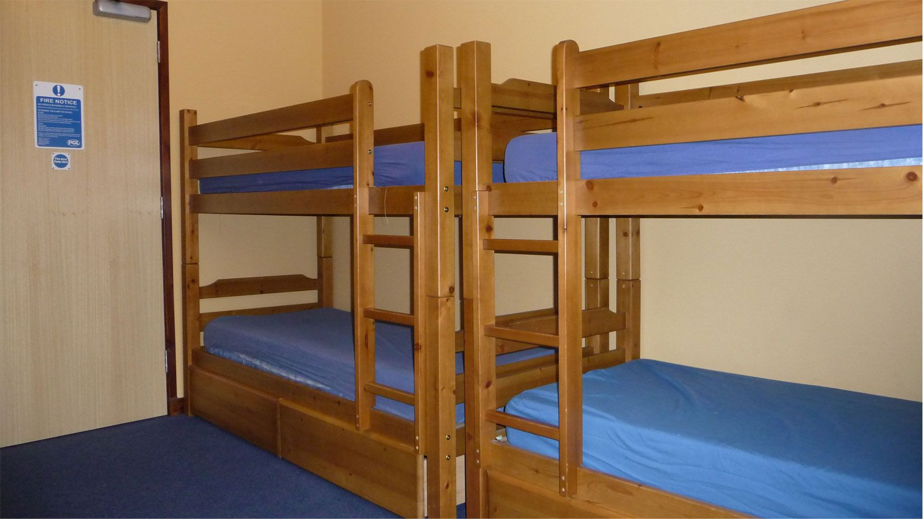
Sleeping Arrangements…

Slide 14
What if…..
I can’t sleep?
I miss home?
Someone is keeping me awake?
I don’t want to take part in an activity?

Slide 15
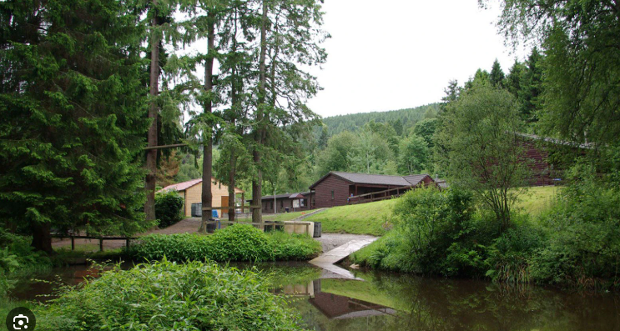
What do we expect?
Ready
Respectful
Safe
Code of Conduct
Have fun!

Slide 16
Question time!

